Slide 1

Teacher To-Do Mini Intro
Presented By: Sam Gerstner, Alexander Fornette, Noah Nannen, Shlok Sheth & Bronwyn Wedig

Slide 2
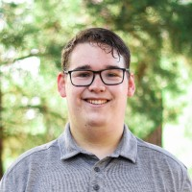
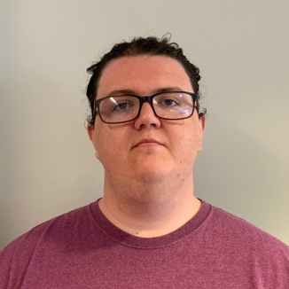
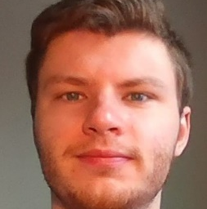
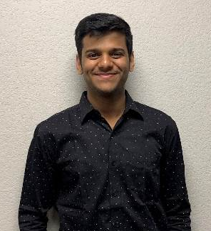
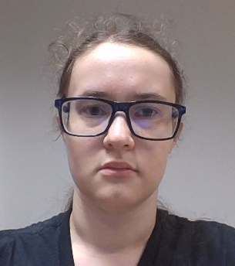
Team Introduction
Sam Gerstner
Team Lead
Alexander Frenette
Backend Developer
Noah Nannen
User Interface Developer
Shlok Sheth
Full Stack Developer
Bronwyn Wedig
Front End Manager
Chris Aungst
Project Sponsor

Slide 3
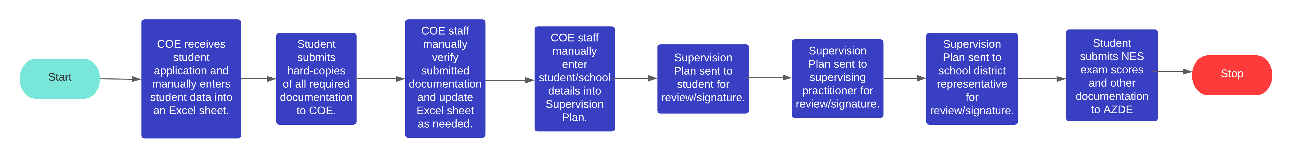
Current Solution Overview/Problems
COE staff currently use a manual process to track requirements for each individual student teacher in an Excel spreadsheet.
The STIC program is available to 12 different degree programs each with different requirements that must be managed.
COE staff spend over 200 hours each semester on this process that could be used to provide other services to COE students.
Accuracy and completeness are key aspects of this process because we must represent the University in a positive light.

